Slide 1
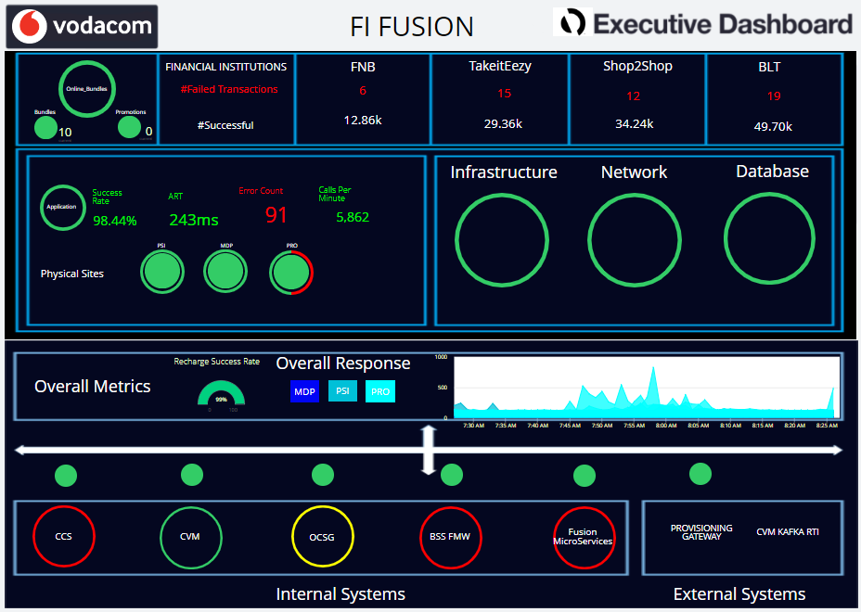
UPSTREAM ONLINE bundles and incoming TOP 4 FI Transactions
FI Fusion 2.0
White for Successful and Red indicating the number of failed transactions. Calculations based on Audit response codes in data.
Application Health with per site view and error count
Health of Physical Infrastructure, Network and DB indicators
INTEGRATION LAYER to all downstream systems including external, focusing on response time indicators.
Downstream systems including external, with application health status where AppD is instrumented

